Slide 1
Switching and Routing
IP Lookup – Binary and Multibit Trie Algorithms (NFV)
Project Presentation
Ali Calis (10709277)
Matteo Conci (10488896)

Slide 2
Agenda
Project Description and Goals
IP lookup: Binary Trie and Multibit Trie
Binary Trie Algorithm: Trie Construction
Binary Trie Algorithm: Prefix Search
Binary Trie Algorithm: Performance Results
Multibit Trie Algorithm: Trie Construction
Multibit Trie Algorithm: Prefix Search
Multibit Trie Algorithm: Performance Results
Binary Trie vs Multibit Trie: Performace Comparison

Slide 3
Project Description & Goals
The goal of this project is to develop a Virtual Network Function in Python code that can implement the IP lookup Binary Trie and Multibit Trie Algorithms inside an NFV environment provided by ADVA.
In brief, the client generates a loop of packets towards the server at frequency rate of 1 pkt/s. At the server side, the IP addresses are subjected to Binary Trie lookup algorithm or Multibit Trie lookup algorithm ,in order to find the longest prefix match.
To reach this scope, the project has been firstly developed and tested locally on our laptop, then it has been tested on two Ubuntu VMs to simulate the client and server behavior, and finally it has been tested inside ADVA testbed.
Before going into project details, let's summarize briefly how the Binary Trie and Multibit Trie Algorithms work.

Slide 4
IP lookup: Binary Trie and Multibit Trie
What is IP Lookup? It is a Routing Function carried out by the Network Processor (NP) of a Router with the goal of forward an incoming packets to the right destination.
In order to understand which is the right destination of a packet, the router performs the IP lookup that can be done through different lookup algorithms, two of these are the Binary Trie (aka Unibit Trie) and the MultiBit Trie.
The starting point for IP address lookup is the Routing Table, a table inside the router that is made of entries. Each entry is a line composed by fields that appears in columns: destination address prefix, next-hop and output interface. When a packet enters the router, its destination IP address is extracted from the IP header and then the router starts the lookup operation:
identify all the entries of the routing table in which the network prefix is matching with the destination IP address
choose between all the matching entries the one with the longest prefix match
At the end of the lookup operation the packets is fowarded along the right destination.

Slide 5
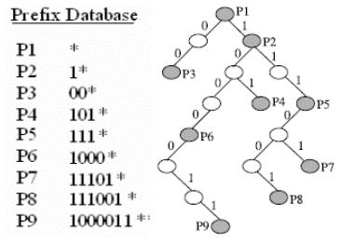
Binary Trie Algorithm: Trie Construction
Before being able to perform the lookup operation of an incoming packets, we first need to build a data structure on which process the packets : the trie. A trie is a data structure based on the tree topology, but specific oriented to the retrivial operations. In particular, it is a multi-way tree with each node containing next-hop info and 0/1/2 pointers to child node(s).
Let’s now see how to build the Binary trie. Starting from the root node that corresponds to the shortest prefix in the DB (usually the default route), we moving down to the next level of the trie inspecting all the possible values of the next bit. A convention is decided for the whole trie, e.g. 0 bit corresponds to a left arc and 1 bit corresponds to a right arc. Each arc is terminated by a new node, that can be
grey, if it corresponds to an entry in the routing
table, or white, otherwise. This procedure is
iterated until the final number of trie levels is
equal to the lenght of the longest prefix.

Slide 6
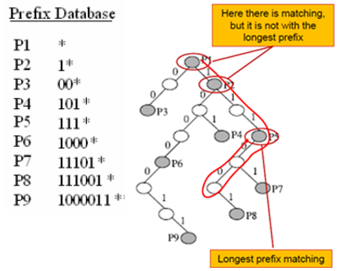
Binary Trie Algorithm: Route Lookup
Once the Binary Trie has been built, it is possible to perform the route lookup. How to perform it ? Starting from the trie route node, for each bit in the destination address, we move to the left child if the bit is a 0, or we move to the right child if the bit is a 1. While crossing the trie, if a grey node is met his prefix is stored in a variable. At the end, the longest prefix match for the destination IP is the one stored in the variable.
Let’s see how this procedure is
implemented.

Slide 7
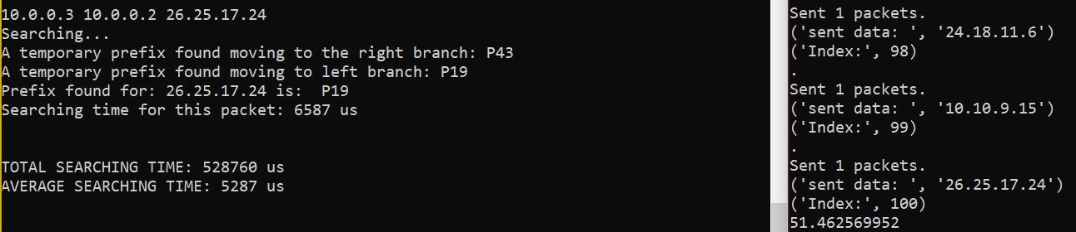
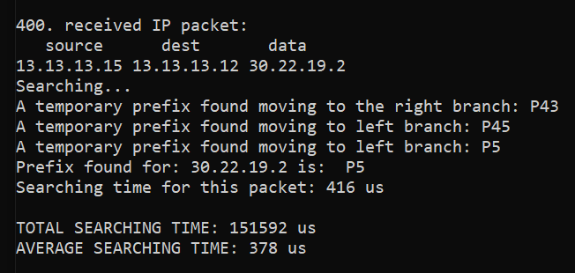
Binary Trie Algorithm: Performance Results
The Binary Trie Algorithm performance evaluation on the Virtual machine is based on the average time spent by the server to solve the list of 100 IP addresses sent by the client. This is the result obtained:
The Binary Trie Algorithm performance evaluation on the testbed is based on the average time spent by the server to solve all the 400 IP lookup (100 from each of the 4 client). This is the result obtained:

Slide 8
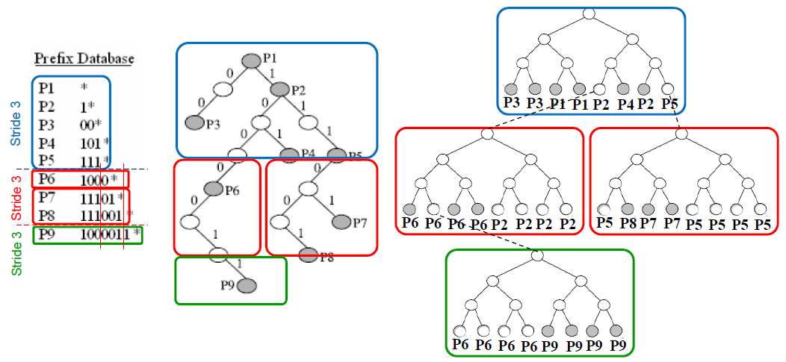
Multibit Trie Algorithm: Trie Construction
A Multibit trie is a trie structure that allows with a memory access to inspect a segment of the path composed of a number of bits defined by the so called Lookup Stride. For istance, if the Lookup Stride is equal to k each trie node has a record of 2^{k} entries and each entry has two fields:
The stored prefix
A pointer to the next child node
With this structure the lookup performance is improved by k times, but the storage complexity is increased: it is O(N*2^{k} *W / K), where N is the number of prefixes, each prefix needs an entire path (W/K) and each node has 2^{k} entries.
To reduce the memory complexity, leaf pushing is used: each node has only one array where prefix and pointers
are compressed together.
Let’s now see how to build
the Multibit trie.

Slide 9
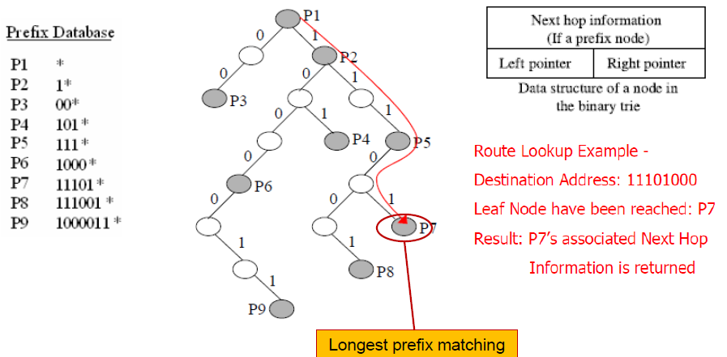
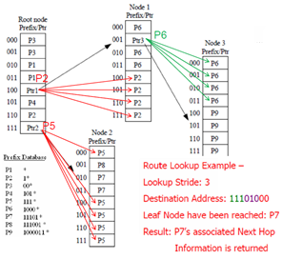
Multibit Trie Algorithm: Route Lookup
Once the Multibit Trie has been built, it is possible to perform the route lookup. How to perform it ? Starting from the first mini trie node, check the record associated to the first k bits:
If there is a pointer, follow it and repeat the procedure taking into account the next k bits
Otherwise, return the prefix stored into the record
As shown in the folowing example, the lookup performance is improved by k times: using a Lookup Stride equal to 3, the lookup operation is performed in 2 memory access instead of 6.
BINARY TRIE
MULTIBIT TRIE

Slide 10
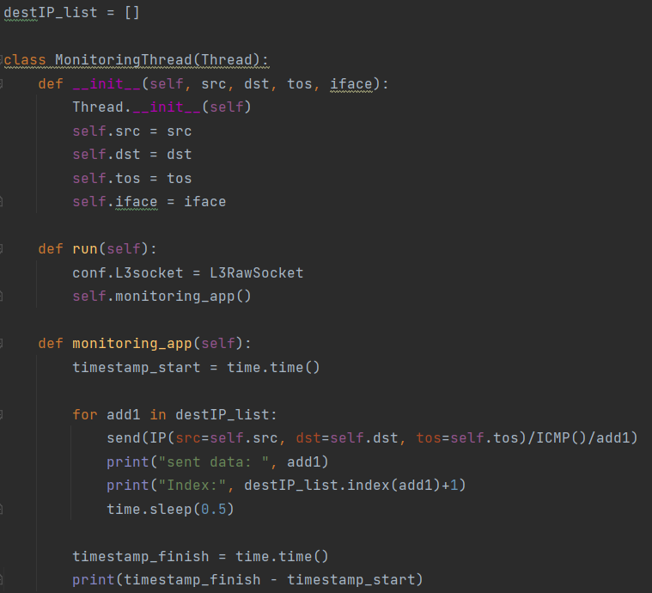
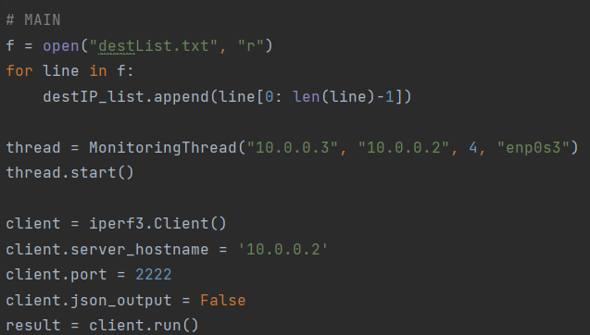
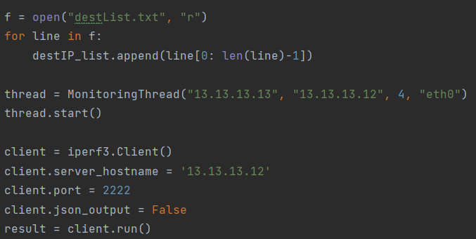
Multibit Trie Algorithm: Route Lookup (code) (cont)
Route Lookup on Vm or Testbed reading IP addresses from file (CLIENT SIDE)
Main for VM
Main for Testbed

Slide 11
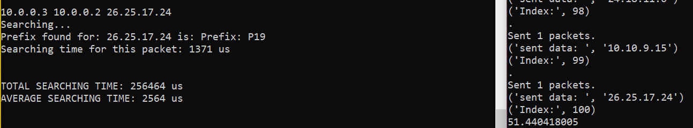
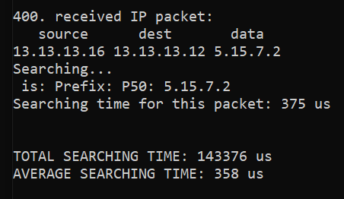
Multibit Trie Algorithm: Performance Results
The Multibit Trie Algorithm performance evaluation on the Virtual Machine is based on the average time spent by the server to solve the list of 100 IP addresses sent by the client. This is the result obtained:
The Multibit Trie Algorithm performance evaluation on the testbed is based on the average time spent by the server to solve all the 400 IP lookup (100 from each of the 4 client). This is the result obtained:

Slide 12
Binary Trie vs Multibit Trie: Performace Comparison
Comparing the two algorithms running on the same list of IP addresses, we have shown that the Multibit Trie is faster than the Binary Trie, on the VM and on the Testbed. In the table there is a recap of the average time taken by the two algorithms running on the VM and on the Testbed.
 | VM | TESTBED
BINARY TRIE | 5287 us | 378 us
MULTIBIT TRIE | 2564 us | 358 us

